Slide 1
Digital Logic Design
Submitted by Jamil Rayhan
ID:18CSE061

Slide 2
Question
Design of a combinational circuit that generates the 10’s complement of a BCD digit.

Slide 3
10's compliment:-
Decimal | BCD | 10’s compliment
 | ABCD | PQRS
0 | 0000 | 1010
1 | 0001 | 1001
2 | 0010 | 1000
3 | 0011 | 0111
4 | 0100 | 0110
5 | 0101 | 0101
6 | 0110 | 0100
7 | 0111 | 0011
8 | 1000 | 0010
9 | 1001 | 0001
d(ABCD)=∑(10,11,12,13,14,15)

Slide 4
K-map for P
AB\CD | 00 | 01 | 11 | 10
00 | 1 | 1 | 0 | 1
01 | 0 | 0 | 0 | 0
11 | x | x | x | x
10 | 0 | 0 | x | x
P=A’B’C’+A’B’D’

Slide 5
K-map for Q
AB\CD | 00 | 01 | 11 | 10
00 | 0 | 0 | 1 | 0
01 | 1 | 1 | 0 | 1
11 | x | x | x | x
10 | 0 | 0 | x | x
Q=BC’+BD’+B’CD

Slide 6
K-map for R
AB\CD | 00 | 01 | 11 | 10
00 | 1 | 0 | 1 | 0
01 | 1 | 0 | 1 | 0
11 | X | X | X | X
10 | 1 | 0 | X | X
R=C’D’+CD

Slide 7
K-map for S
AB\CD | 00 | 01 | 11 | 10
00 | 0 | 1 | 1 | 0
01 | 0 | 1 | 1 | 0
11 | X | X | X | X
10 | 0 | 1 | X | X
S=D

Slide 8
All functions
P=A’B’C’+A’B’D’
Q=BC’+BD’+B’CD
R=C’D’+CD
S=D

Slide 9
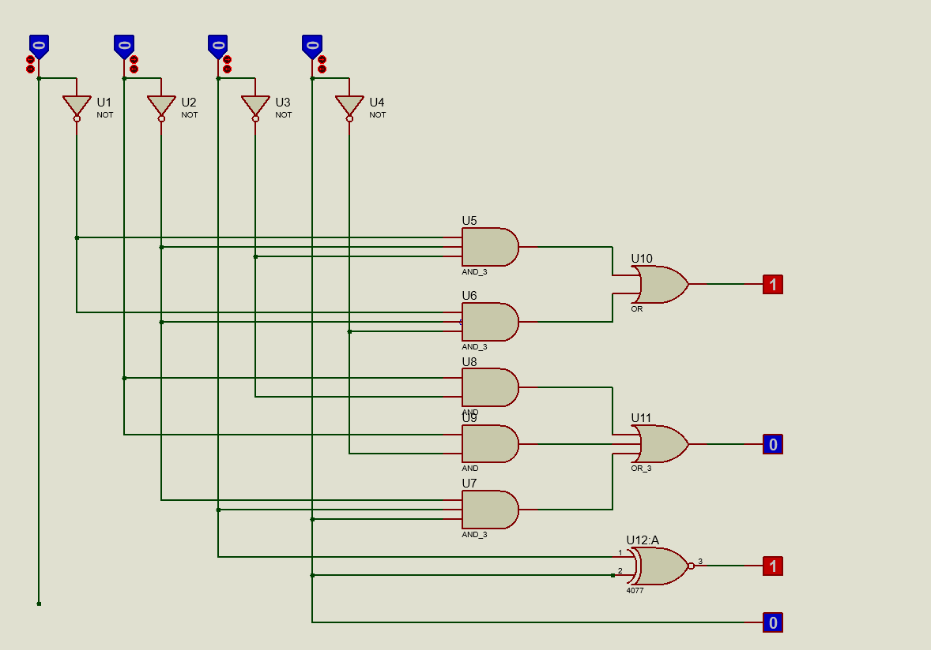
Circuit Diagram
A
B
C
D
P
P
Q
Q
R
S
R
S

Slide 10
Thank you

